Slide 1
English Consonants
ESL DEPARTMENT

Slide 2
ENGLISH CONSONANTS
Overview

Slide 3
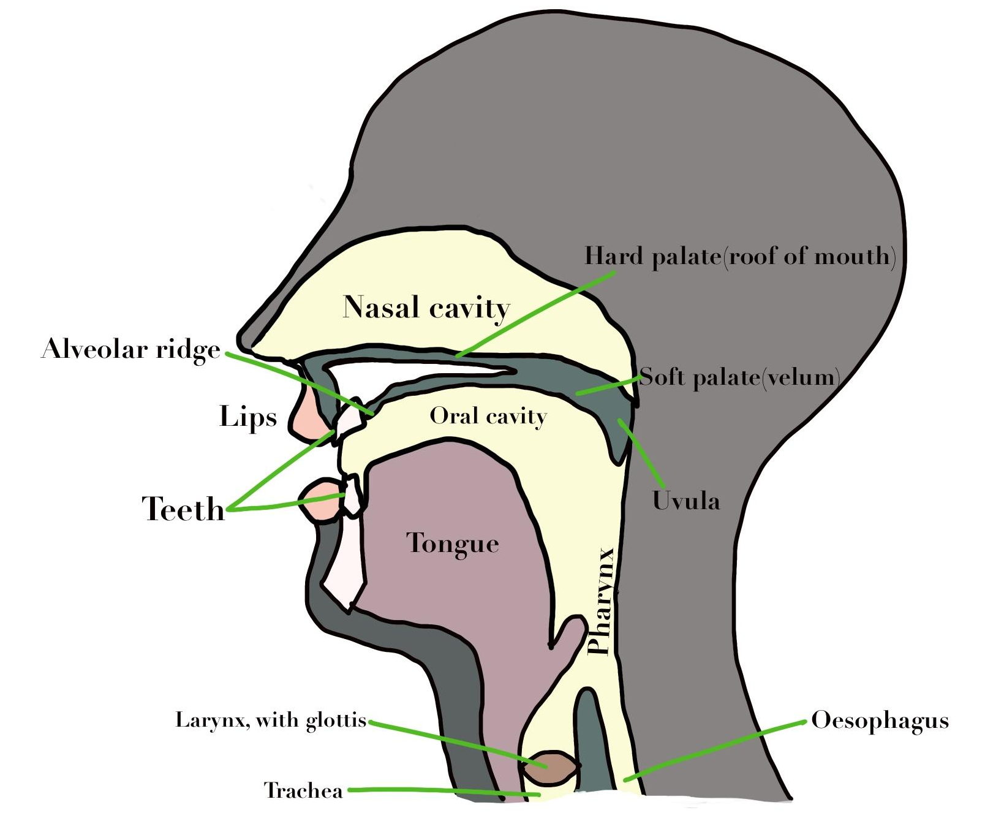
The
Articulators

Slide 4
CONSONANT CHART
Manner of Articulation | Place of Articulation
 | Bilabials Two lips | Labiodentals Upper teeth Lower lip | Dentals Tip of the tongue between teeth | Alveolars Tip of the tongue against alveolar ridge | Palatals Tip of the tongue between alveolar ridge and hard palate | Velars Tongue against soft palate | Glottals Vocal cords
Oral Stop voiceless voiced | p b |  |  | t d |  | k g
Fricative voiceless voiced |  | f v | θ ð | s z | ʃ ʒ |  | h
Affricate voiceless voiced |  |  |  |  | ʧ ʤ
Nasal voiced | m |  |  | n |  | ŋ
Liquid voiced |  |  |  | l | r
Glide voiced | w |  |  |  | y

Slide 5
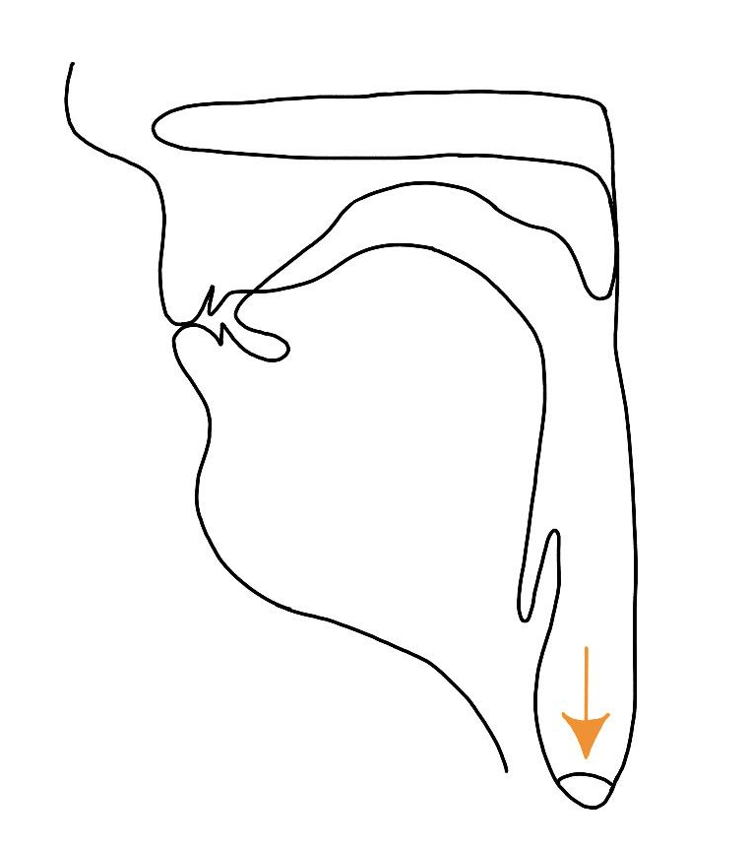
/p/
Produced between both lips
Voiceless
Oral stop with 3 phases:
Start in complete closure,
Build-up of pressure,
Release
Aspirated
Pet, Lapse, Tap

Slide 6
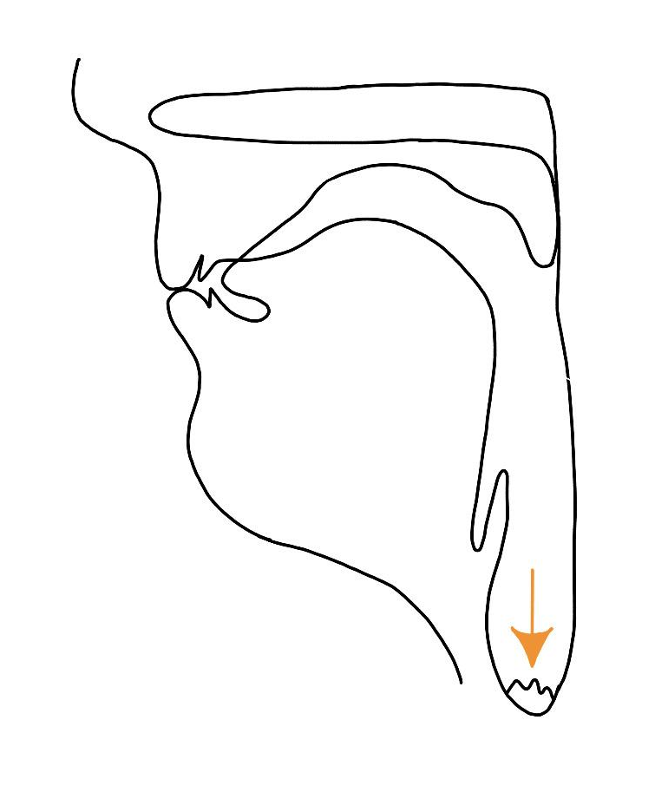
/b/
Produced between both lips
Voiced
Oral stop with 3 phases:
Start in complete closure,
Build-up of pressure,
Release
Bear, Abdomen, Tab

Slide 7
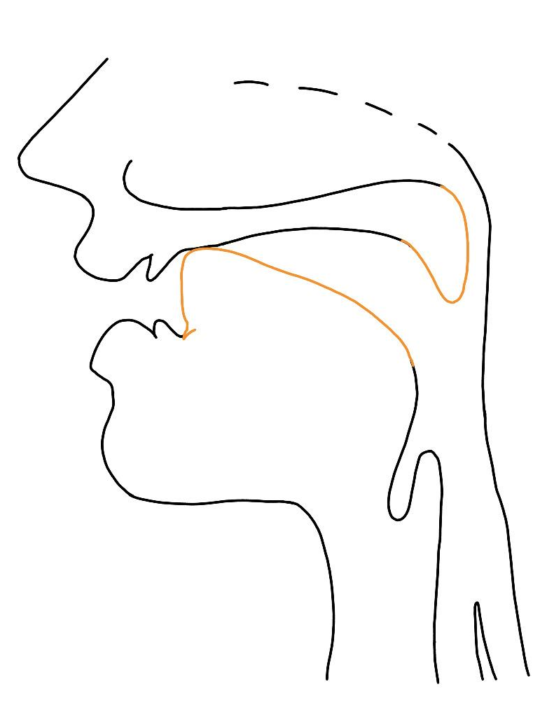
/t/
Produced with the tip of the tongue against the alveolar ridge
Voiceless
Oral stop with 3 phases:
Start in complete closure,
Build-up of pressure,
Release
Aspirated
Top, Intake, Sit

Slide 8
/d/
Produced with the tip of the tongue against the alveolar ridge
Voiced
Oral stop with 3 phases:
Start in complete closure,
Build-up of pressure,
Release
Dome, Adore, Land

Slide 9
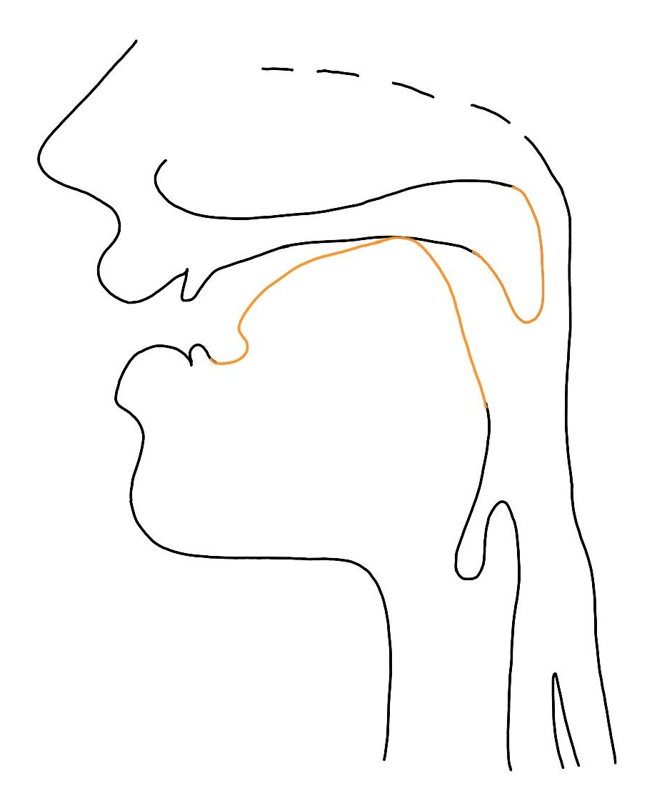
/k/
Produced with the tongue against soft palate
Voiceless
Oral stop with 3 phases:
Start in complete closure,
Build-up of pressure,
Release
Aspirated
Cat, Acute, Lack

Slide 10
/g/
Produced with the tongue against soft palate
Voiced
Oral stop with 3 phases:
Start in complete closure,
Build-up of pressure,
Release
Gouda, Again, Log

Slide 11
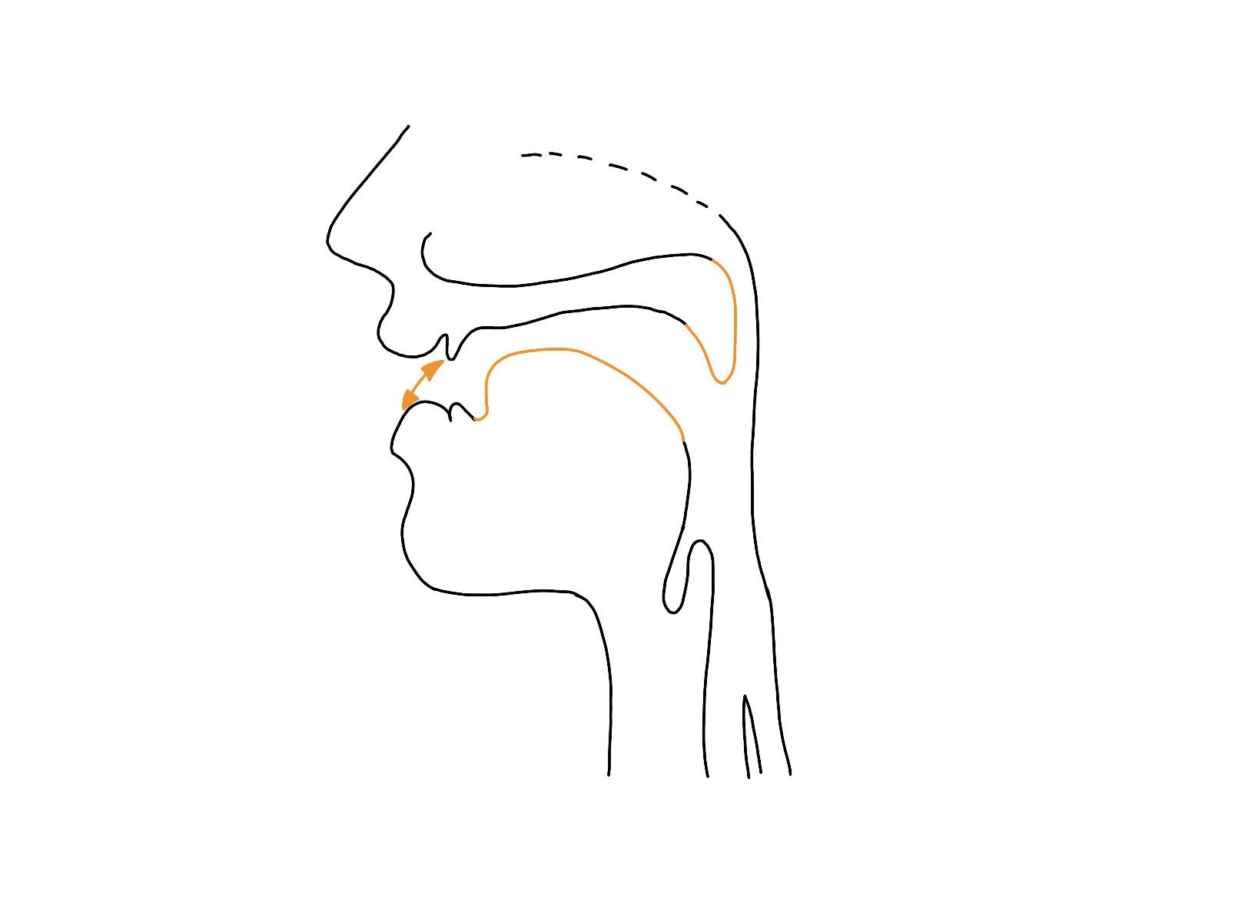
/f/
Produced between the upper teeth and the lower lip
Voiceless
Narrow opening of the mouth with friction
Far, Afar, Laugh

Slide 12
/v/
Produced between the upper teeth and the lower lip
Voiced
Narrow opening of the mouth with friction
Vet, Lavish, Love

Slide 13
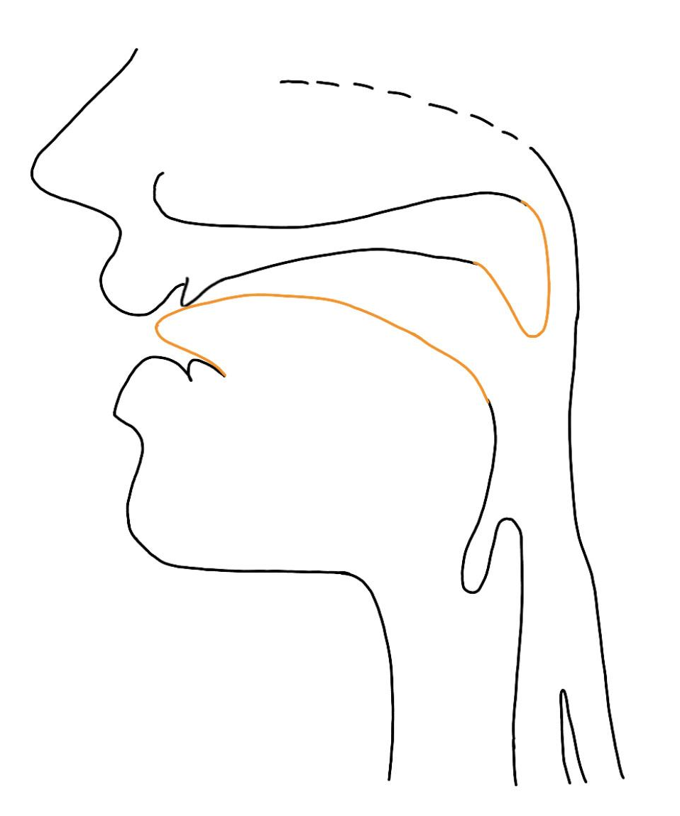
/θ/ “theta”
Produced with the blade of the tongue between upper and lower teeth
Voiceless
Narrow opening of the mouth with friction
Think, Lithium, Both

Slide 14
/ð/ “eth”
Produced with the blade of the tongue between upper and lower teeth
Voiced
Narrow opening of the mouth with friction
That, Brother, Soothe

Slide 15
/s/
Produced with the tip of the tongue against the alveolar ridge
Voiceless
Narrow opening of the mouth with friction
Sink, Ask, Less

Slide 16
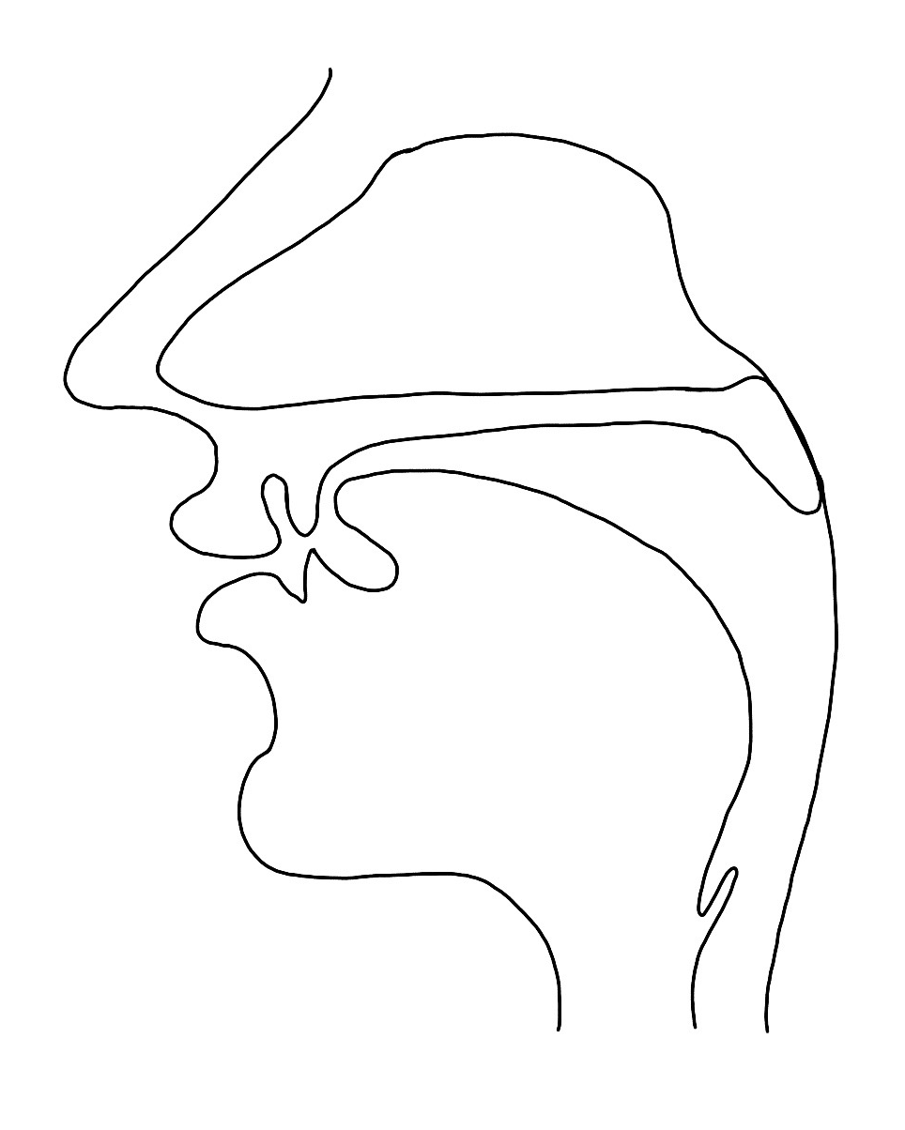
/z/
Produced with the tip of the tongue against the alveolar ridge
Voiced
Narrow opening of the mouth with friction
Zinc, Azure, Doze

Slide 17
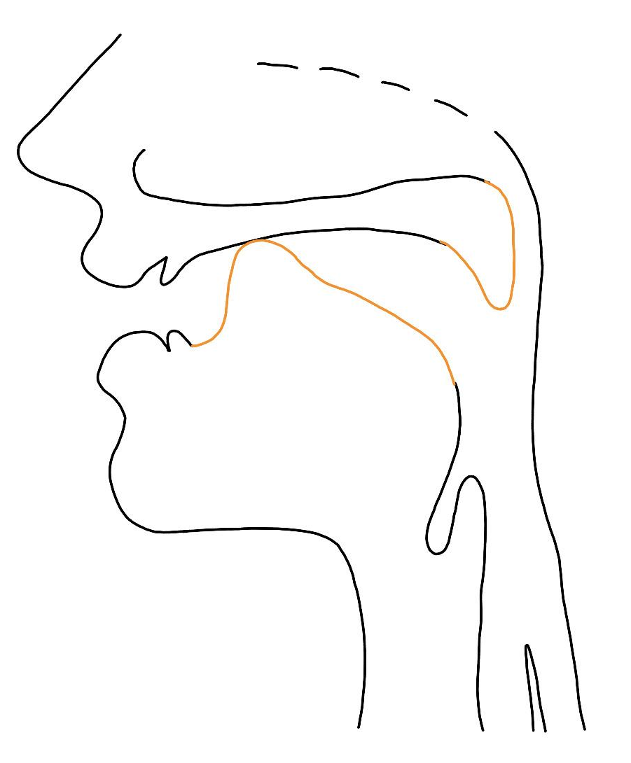
/ʃ/ “esh”
Produced with the top of the tongue between alveolar ridge and hard palate
Voiceless
Narrow opening of the mouth with friction
Sharp, Lotion, Ash

Slide 18
/ʒ/ “yogh”
Produced with the top of the tongue between alveolar ridge and hard palate
Voiced
Narrow opening of the mouth with friction
Lesion, Rouge

Slide 19
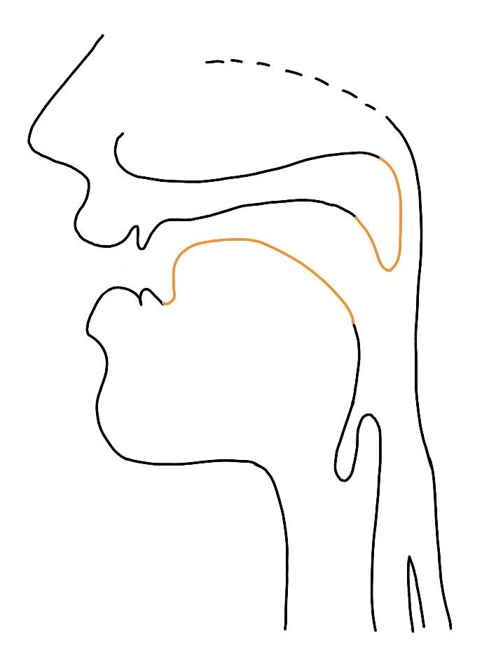
/h/
Produced between the vocal cords
Voiceless
Narrow opening of the mouth with friction
Half, Ahead

Slide 20
/tʃ/ ”t-esh”
Produced with the tip of the tongue between alveolar ridge and hard palate
Voiceless
Begin as oral stops with built-up pressure, end with narrow opening and friction
Chore, Latch

Slide 21
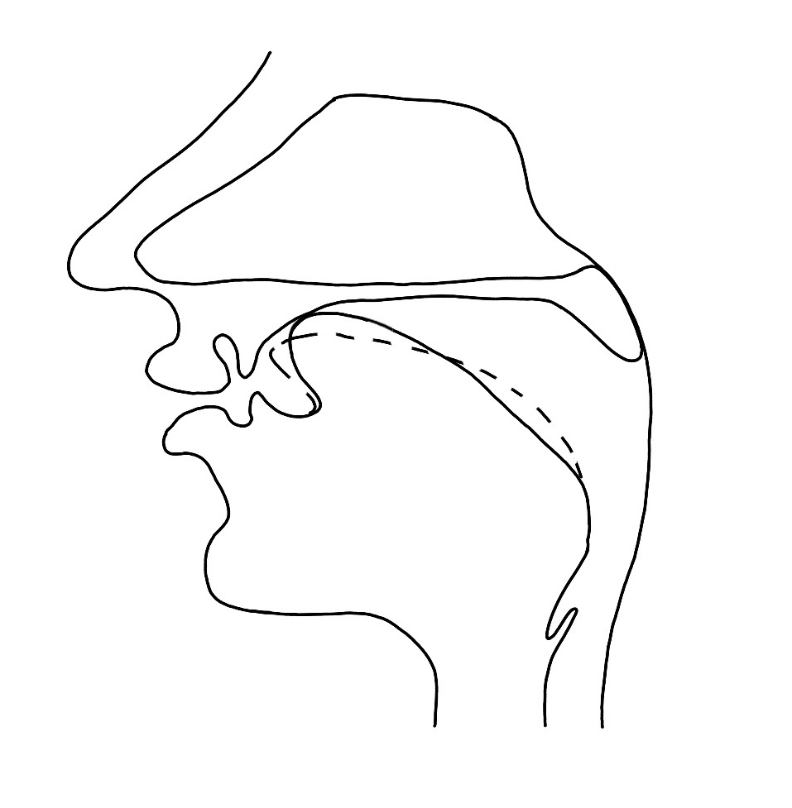
/dʒ/ ”d-yogh”
Produced with the tip of the tongue between alveolar ridge and hard palate
Voiceless
Begin as oral stops with built-up pressure, end with narrow opening and friction
Jar, Major, Edge

Slide 22
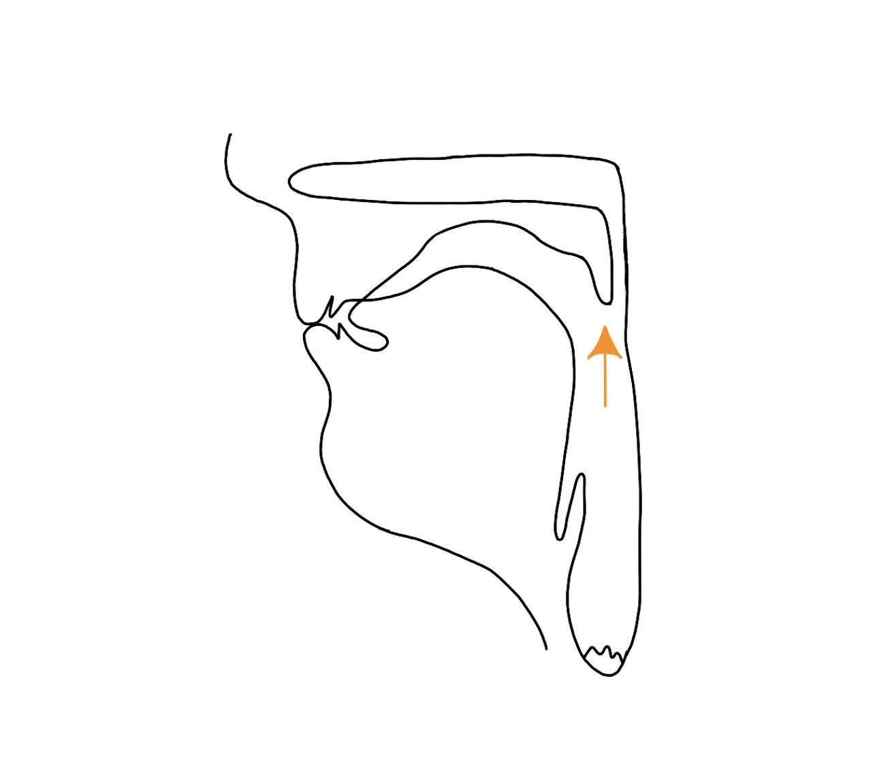
/m/
Produced between both lips
Voiced
Nasal sound: Velum is lowered, the air passes through the nose
Mouse, Amuse, Team

Slide 23
/n/
Produced with the tip of the tongue against the alveolar ridge
Voiced
Nasal sound: Velum is lowered, the air passes through the nose
Neat, Annotate, Lane

Slide 24
/ŋ/ “eng/engma”
Produced with the tip of the tongue against the alveolar ridge
Voiced
Nasal sound: Velum is lowered, the air passes through the nose
Ringer, Singer

Slide 25

/l/
Produced with the tip of the tongue against the alveolar ridge
Voiced
Light, Halt, Hall

Slide 26
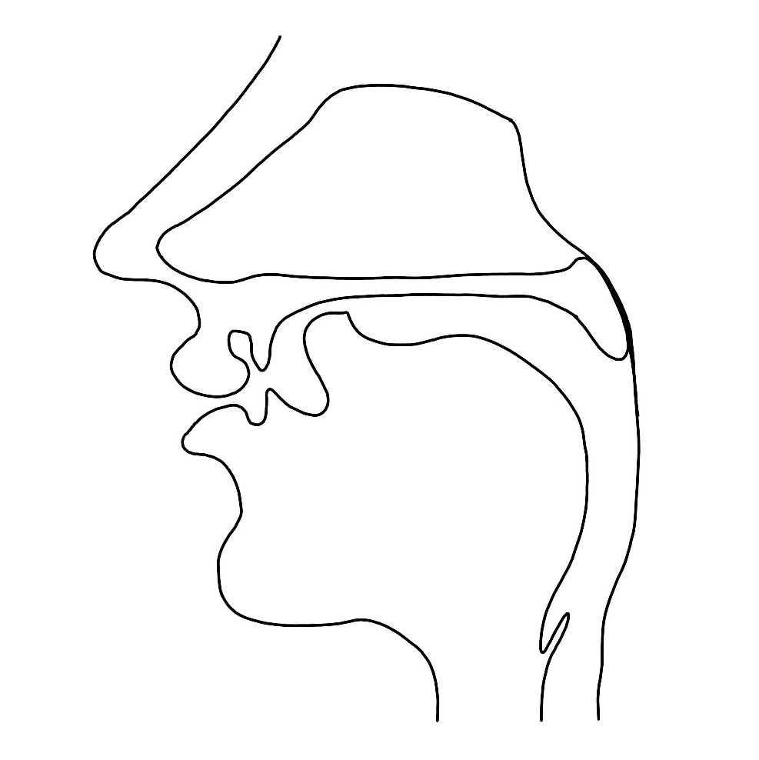
/r/
Produced with the top of the tongue between alveolar ridge and hard palate
Voiced
Raw, Prowl, Scar

Slide 27
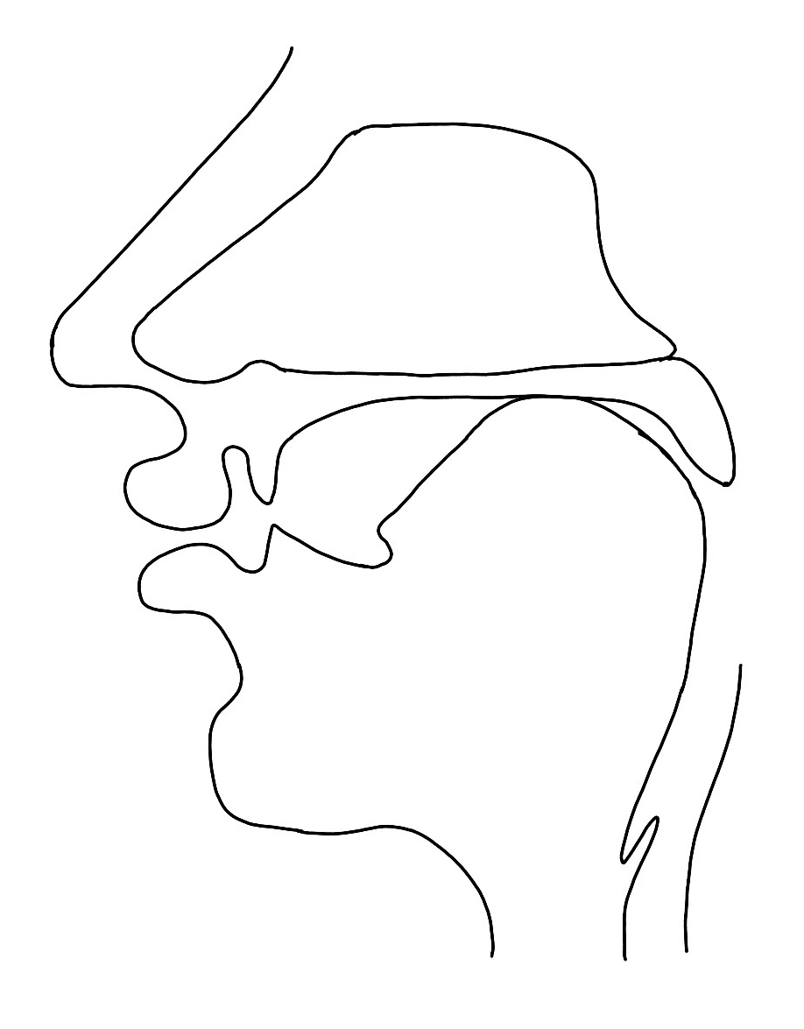
/w/
Produced between both lips
Voiced
Wet, Await

Slide 28
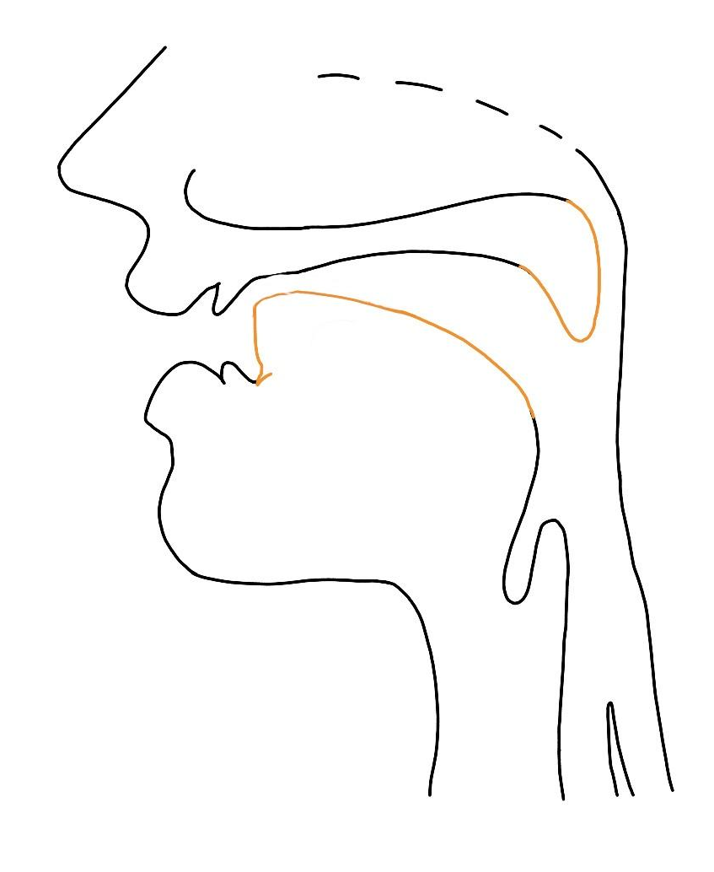
/y/
Produced with the tongue blade against the hard palate
Voiced
Yet, Layer, Alloy

